Slide 1
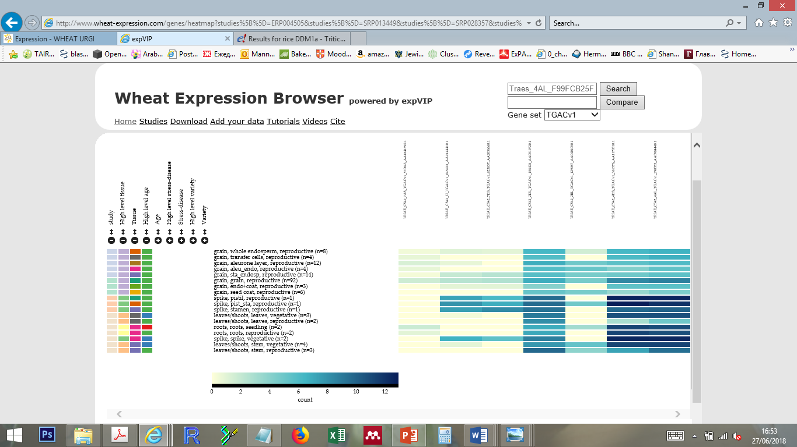
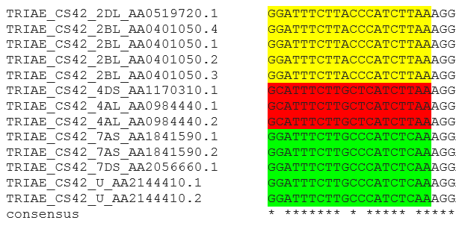
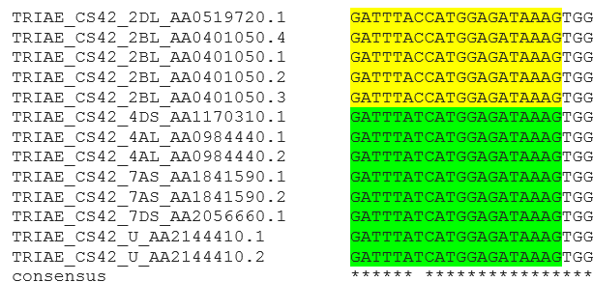
A
7AS
U
7DS
2BL
2DL
4DS
4AL
B
grain
 | 7AS | 7DS | U | 2BL | 2DL | 4DS
7DS | 91.4
U | 90.7 | 97.7
2BL | 77.4 | 83.8 | 83.5
2DL | 77.6 | 84.1 | 84.1 | 98.8
4DS | 83.0 | 85.1 | 84.7 | 82.1 | 82.4
4AL | 82.9 | 84.8 | 84.5 | 81.8 | 82.2 | 98.6
spike, pistil, stamen
leaf, shoot, root, stem, seedling
counts (log2 scale)
Coiled-coil
C
DEAD-like
SNF2
Helicase
TaDDM1
Chr 2
Chr 2
Chr 4
Chr 4
Chr 7
Chr 7
Chr U
Chr U
photospacer
photospacer
PAM
PAM

